Slide 1
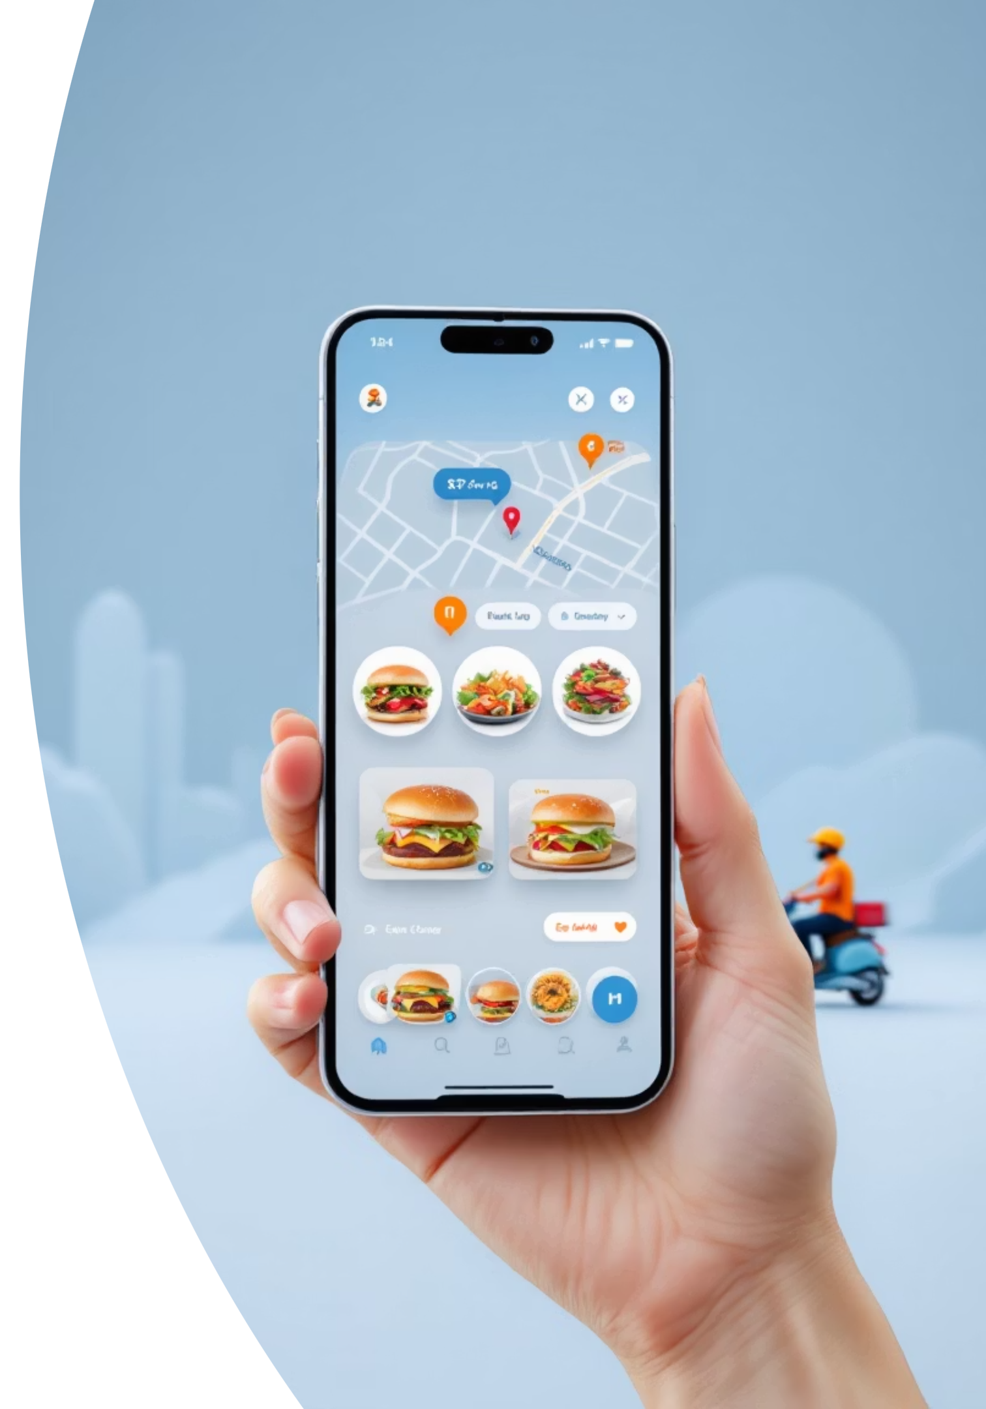
Cloud Kitchen Application
Complete User Experience & Admin Management System
Created by: Prince Kumar
Anudip ID: AF04983162
This is a comprehensive showcase of a modern cloud kitchen platform with user-friendly interface and robust admin controls.

Slide 2
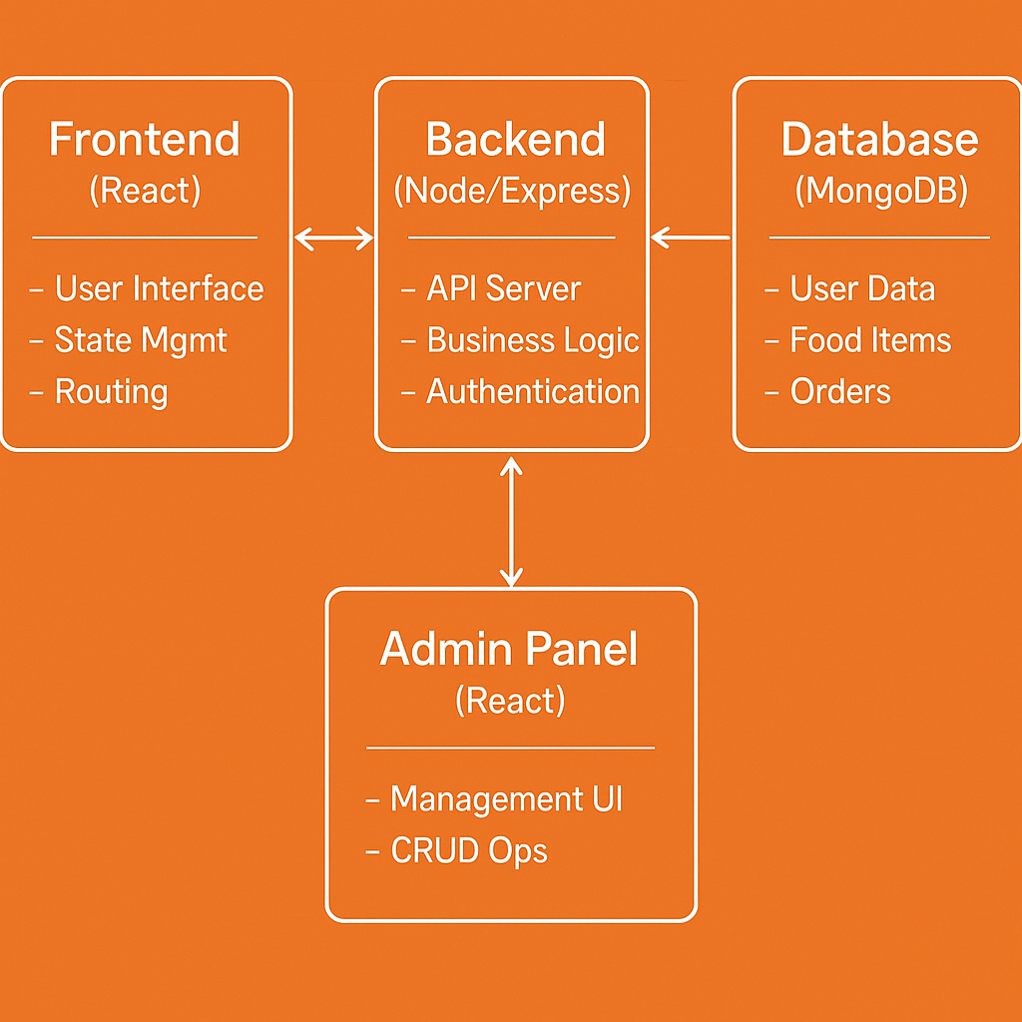
Tech Stack : React.js , Node.js , Express.js , MongoDB , JWT , Axios, Stripe, Firebase.
System Architecture

Slide 3
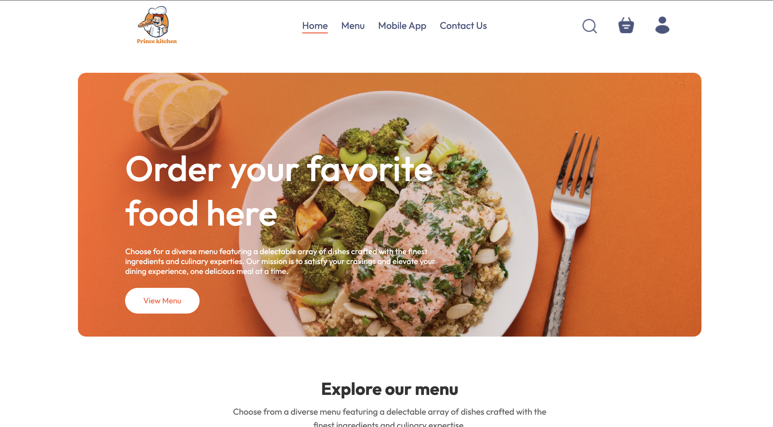
Effortless Discovery: Your Culinary Journey Begins Here
Our intuitive home screen serves as the gateway to a world of culinary delights, designed for seamless navigation and personalized exploration. Users can effortlessly browse, search, and discover local restaurants and diverse cuisines tailored to their preferences.
Key Features for Enhanced User Experience:
Personalized Recommendations: Leveraging advanced algorithms, the app suggests restaurants and dishes based on past orders, dietary preferences, and location.
Robust Search & Filtering: A prominent search bar allows for quick discovery by restaurant name or dish, complemented by extensive filters for cuisine type, price range, ratings, and delivery options (e.g., "fastest delivery," "free delivery").
Curated Categories: Visually appealing category tiles (e.g., "Pizza," "Sushi," "Healthy," "Desserts") enable users to explore specific food types with a single tap, streamlining the decision-making process.
Promotional Highlights: Dynamic banners and dedicated sections showcase current deals, discounts, and featured partners, encouraging user engagement and repeat orders.
Restaurant Overviews: Each restaurant listing provides essential information at a glance, including average rating, estimated delivery time, and pricing, empowering users to make informed choices quickly.
This comprehensive discovery interface ensures that users can find exactly what they're craving with minimal effort, transforming casual browsing into successful orders and establishing our app as the go-to platform for food delivery.

Slide 4
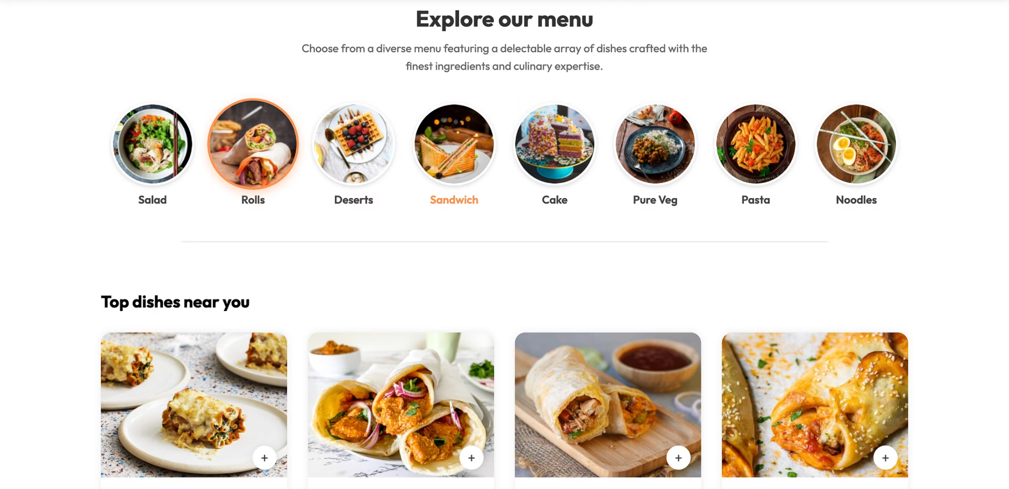
Effortless Discovery: Navigating the Explore Menu
The Explore Menu serves as the primary gateway for users to discover a vast array of dining options available through our food delivery application. Designed for intuitive navigation and quick access, this feature empowers users to effortlessly browse and locate their desired meals or restaurants.
Users are greeted with a comprehensive interface that facilitates both targeted searches and casual browsing. Key functionalities include:
Intuitive Search Bar: Positioned prominently, allowing users to quickly search for specific restaurants, dishes, or cuisines.
Curated Categories: A visually appealing arrangement of food categories (e.g., "Pizza", "Sushi", "Healthy"), enabling users to explore options based on their current cravings or dietary preferences.
Dynamic Filtering: Advanced filters for refining search results by price range, delivery time, customer ratings, distance, and special offers, ensuring a highly personalized selection.
Personalized Recommendations: Leveraging user history and preferences, the menu intelligently suggests restaurants and dishes tailored to individual tastes, enhancing discovery and user engagement.
This robust exploration hub is central to providing a seamless and enjoyable user experience, connecting customers with their next meal efficiently and effectively.

Slide 5
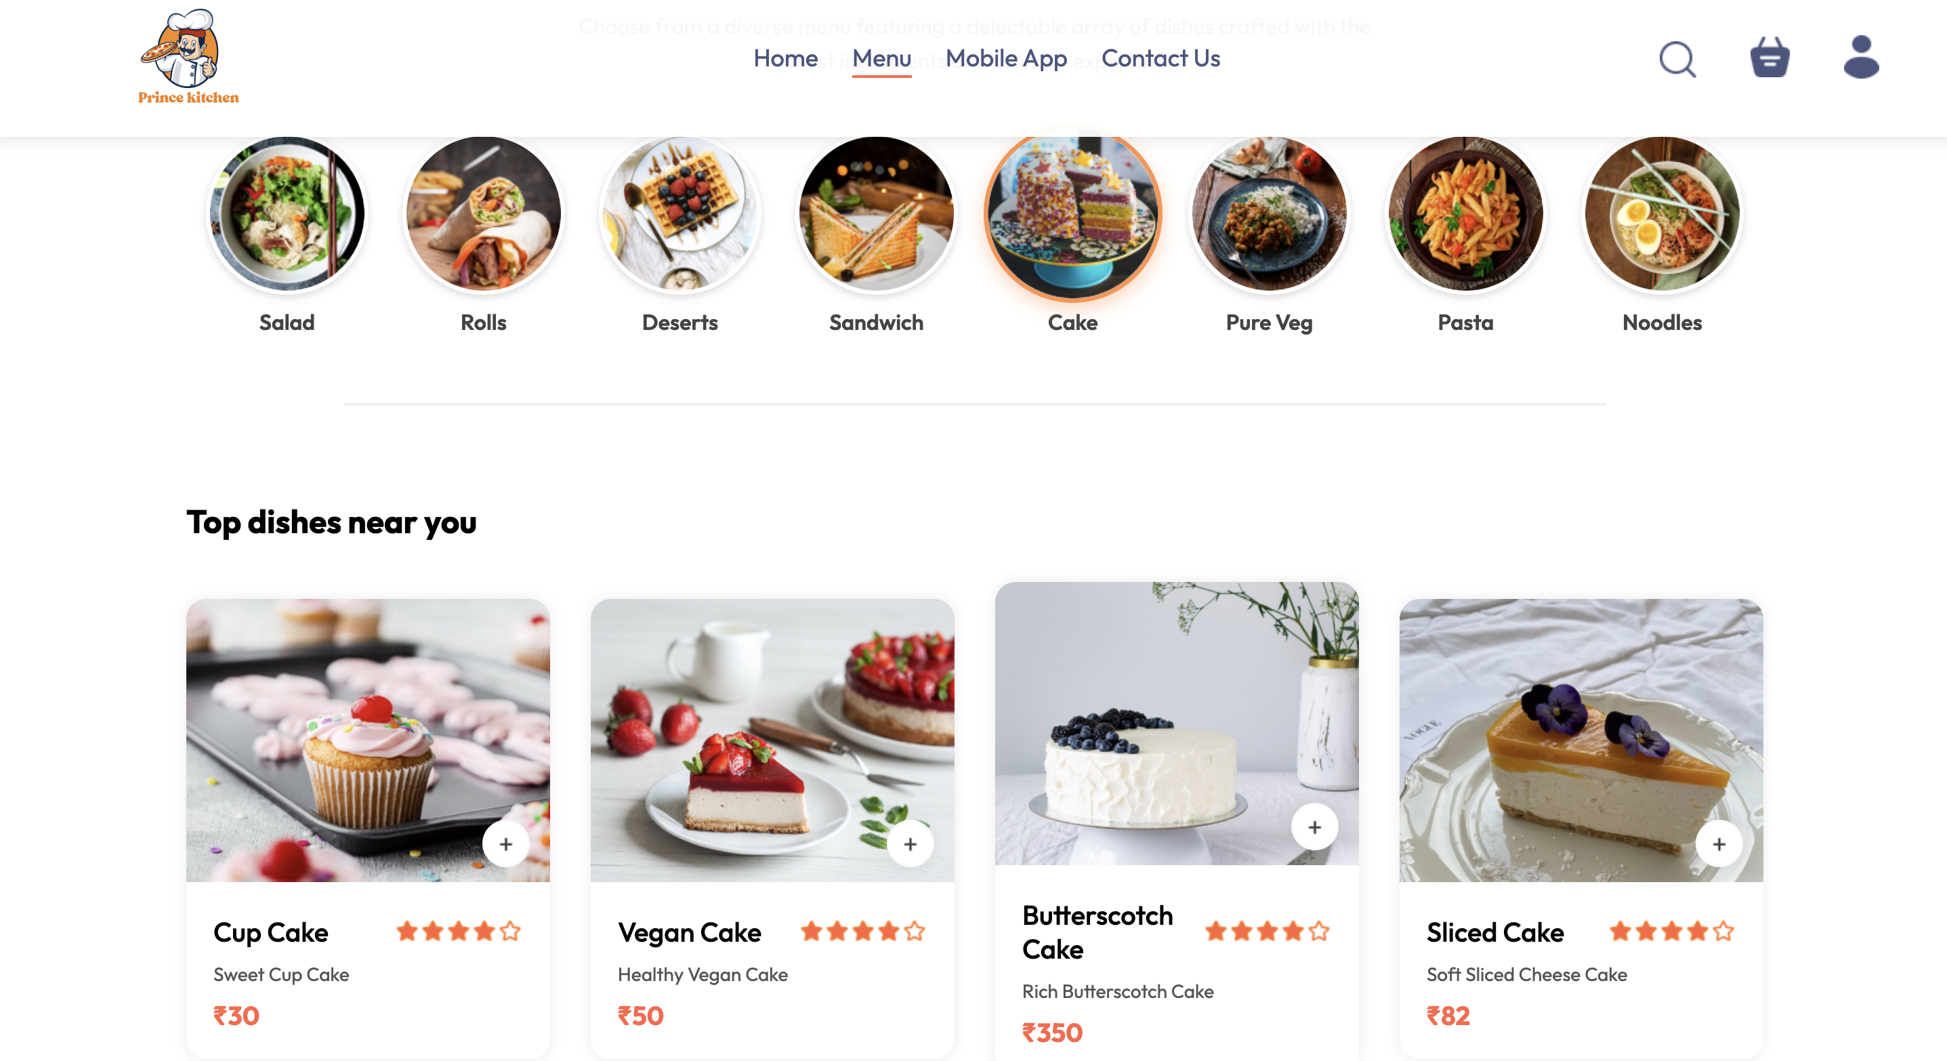
Streamlined Menu Navigation by Category
This screen highlights the intuitive category browsing feature, designed to help users efficiently explore diverse culinary options within the app. Our robust categorization system ensures a seamless and personalized discovery process.
Users can effortlessly filter restaurants and dishes by selecting from a comprehensive range of predefined categories, such as 'Burgers,' 'Pizza,' 'Asian Cuisine,' 'Healthy Options,' or 'Desserts.' This functionality significantly enhances discoverability and provides quick access to their preferred food types, catering to various tastes and dietary needs.
By offering clear, well-organized categories, the app streamlines the decision-making journey, minimizing endless scrolling and allowing users to find exactly what they're craving with speed and precision. This feature is fundamental to optimizing the user experience from initial browsing to successful order placement, ensuring satisfaction and efficiency.

Slide 6
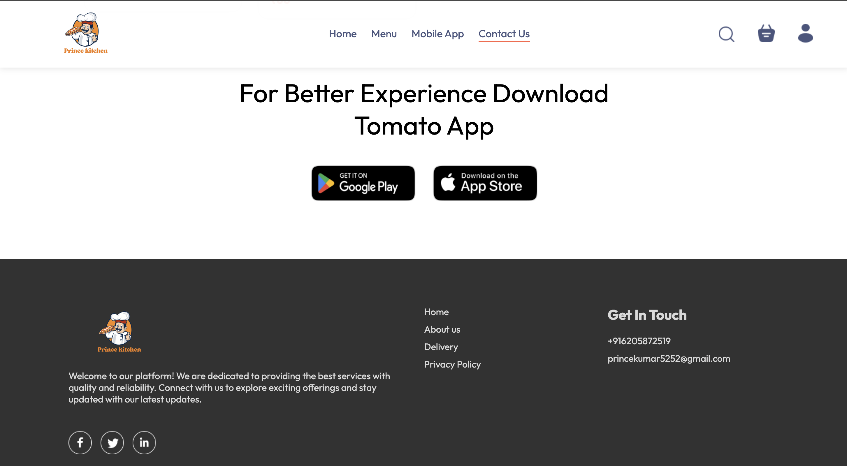
Intuitive Footer Navigation
The persistent footer navigation bar is a critical element of the app's user interface, designed for effortless access to core functionalities from any screen. It ensures a seamless and efficient user experience by providing consistent, one-tap access to key sections, significantly reducing navigation friction.
Home: Allows users to quickly return to the main dashboard, featuring personalized recommendations, ongoing deals, and popular restaurant listings.
Explore: Provides access to a comprehensive search and discovery interface, enabling users to find restaurants, cuisines, or specific dishes based on various filters and preferences.
Orders: A dedicated section where users can view the status of their active orders, track deliveries in real-time, review past orders, and easily reorder favorite meals.
Profile: Offers quick access to user account management, including personal details, payment methods, delivery addresses, communication preferences, and customer support options.

Slide 7
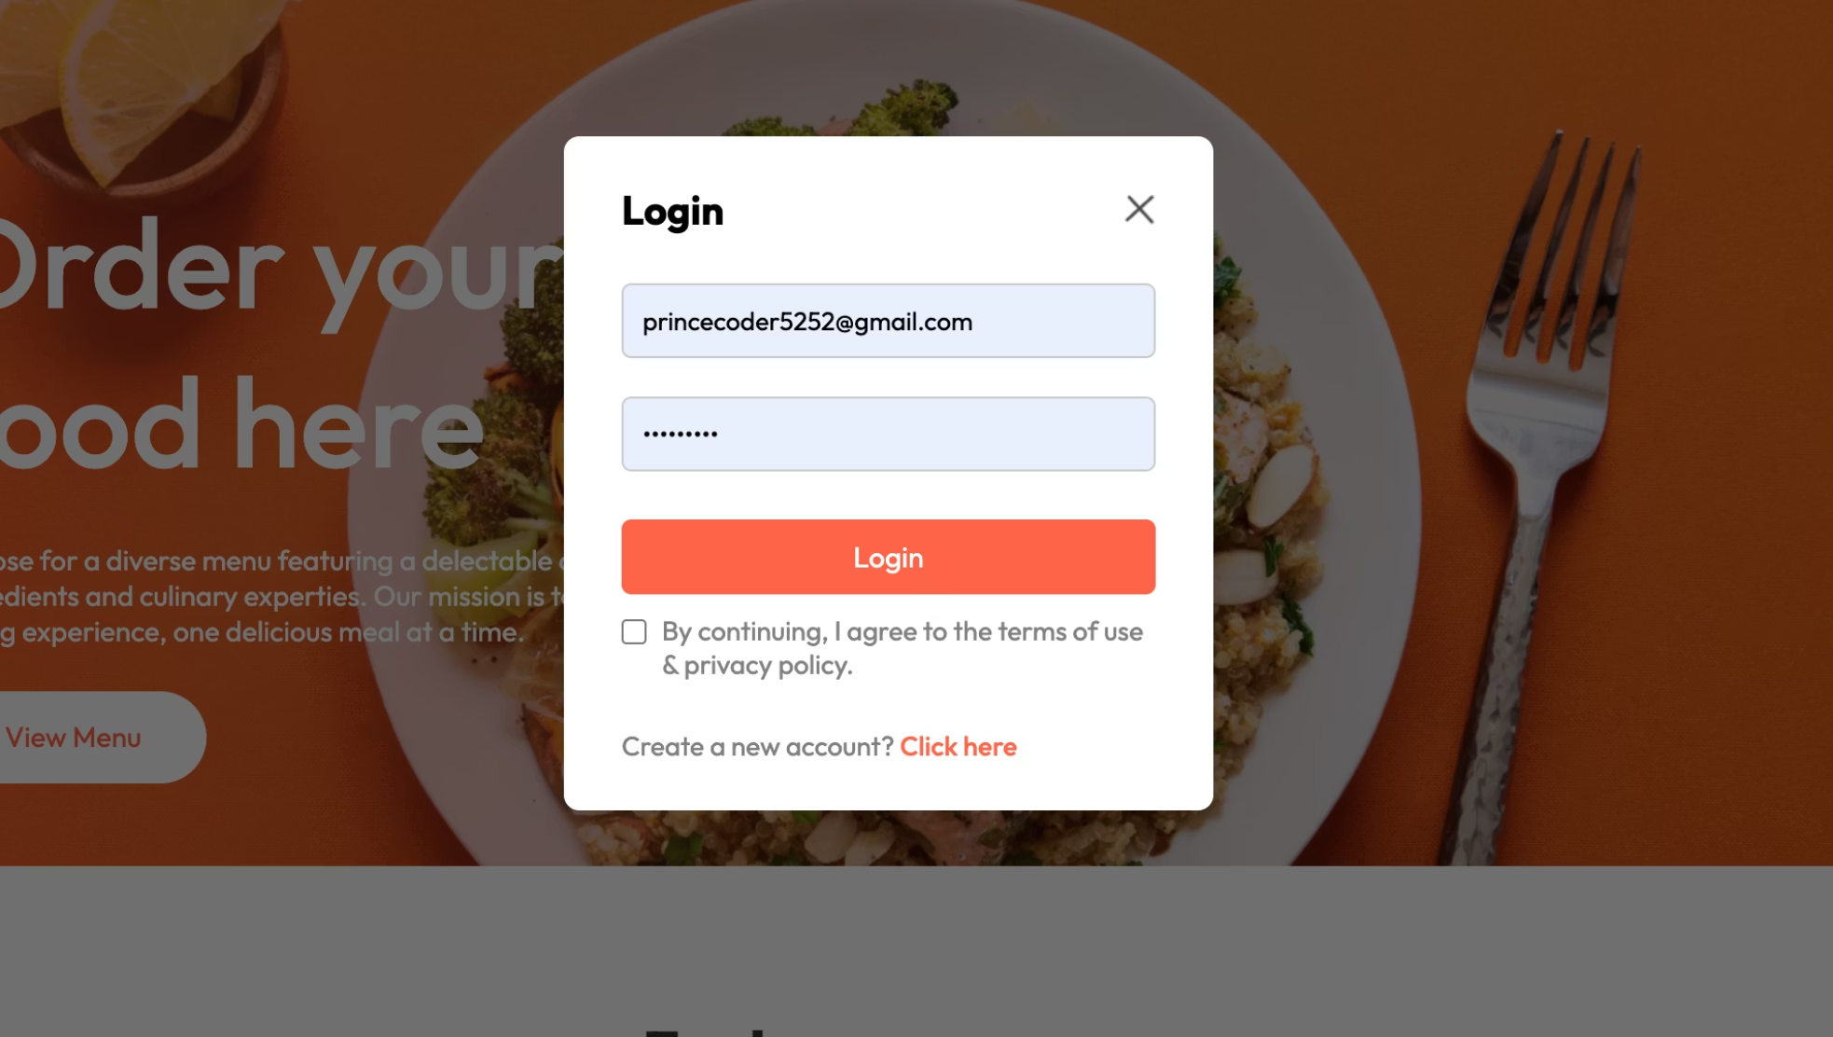
Secure User Login & Account Access
The login screen is the essential gateway for users to access their personalized food delivery experience. It provides a secure and intuitive process for both new and returning customers to manage their orders, preferences, and delivery details.
Key Features and Functionality:
Credential Input: Dedicated fields for email address/username and password ensure a standard authentication process.
"Forgot Password" Option: A prominent link for password recovery streamlines access for users who may have forgotten their credentials, enhancing user experience.
New User Registration: A clear "Sign Up" or "Create Account" option guides prospective customers through a seamless onboarding process.
Social Login Integration: Support for popular social media accounts (e.g., Google, Facebook) offers a convenient and fast alternative for user authentication, reducing friction.
User Journey Entry Point: This screen serves as the primary entry for returning users, connecting them to their order history, saved addresses, and payment methods.

Slide 8
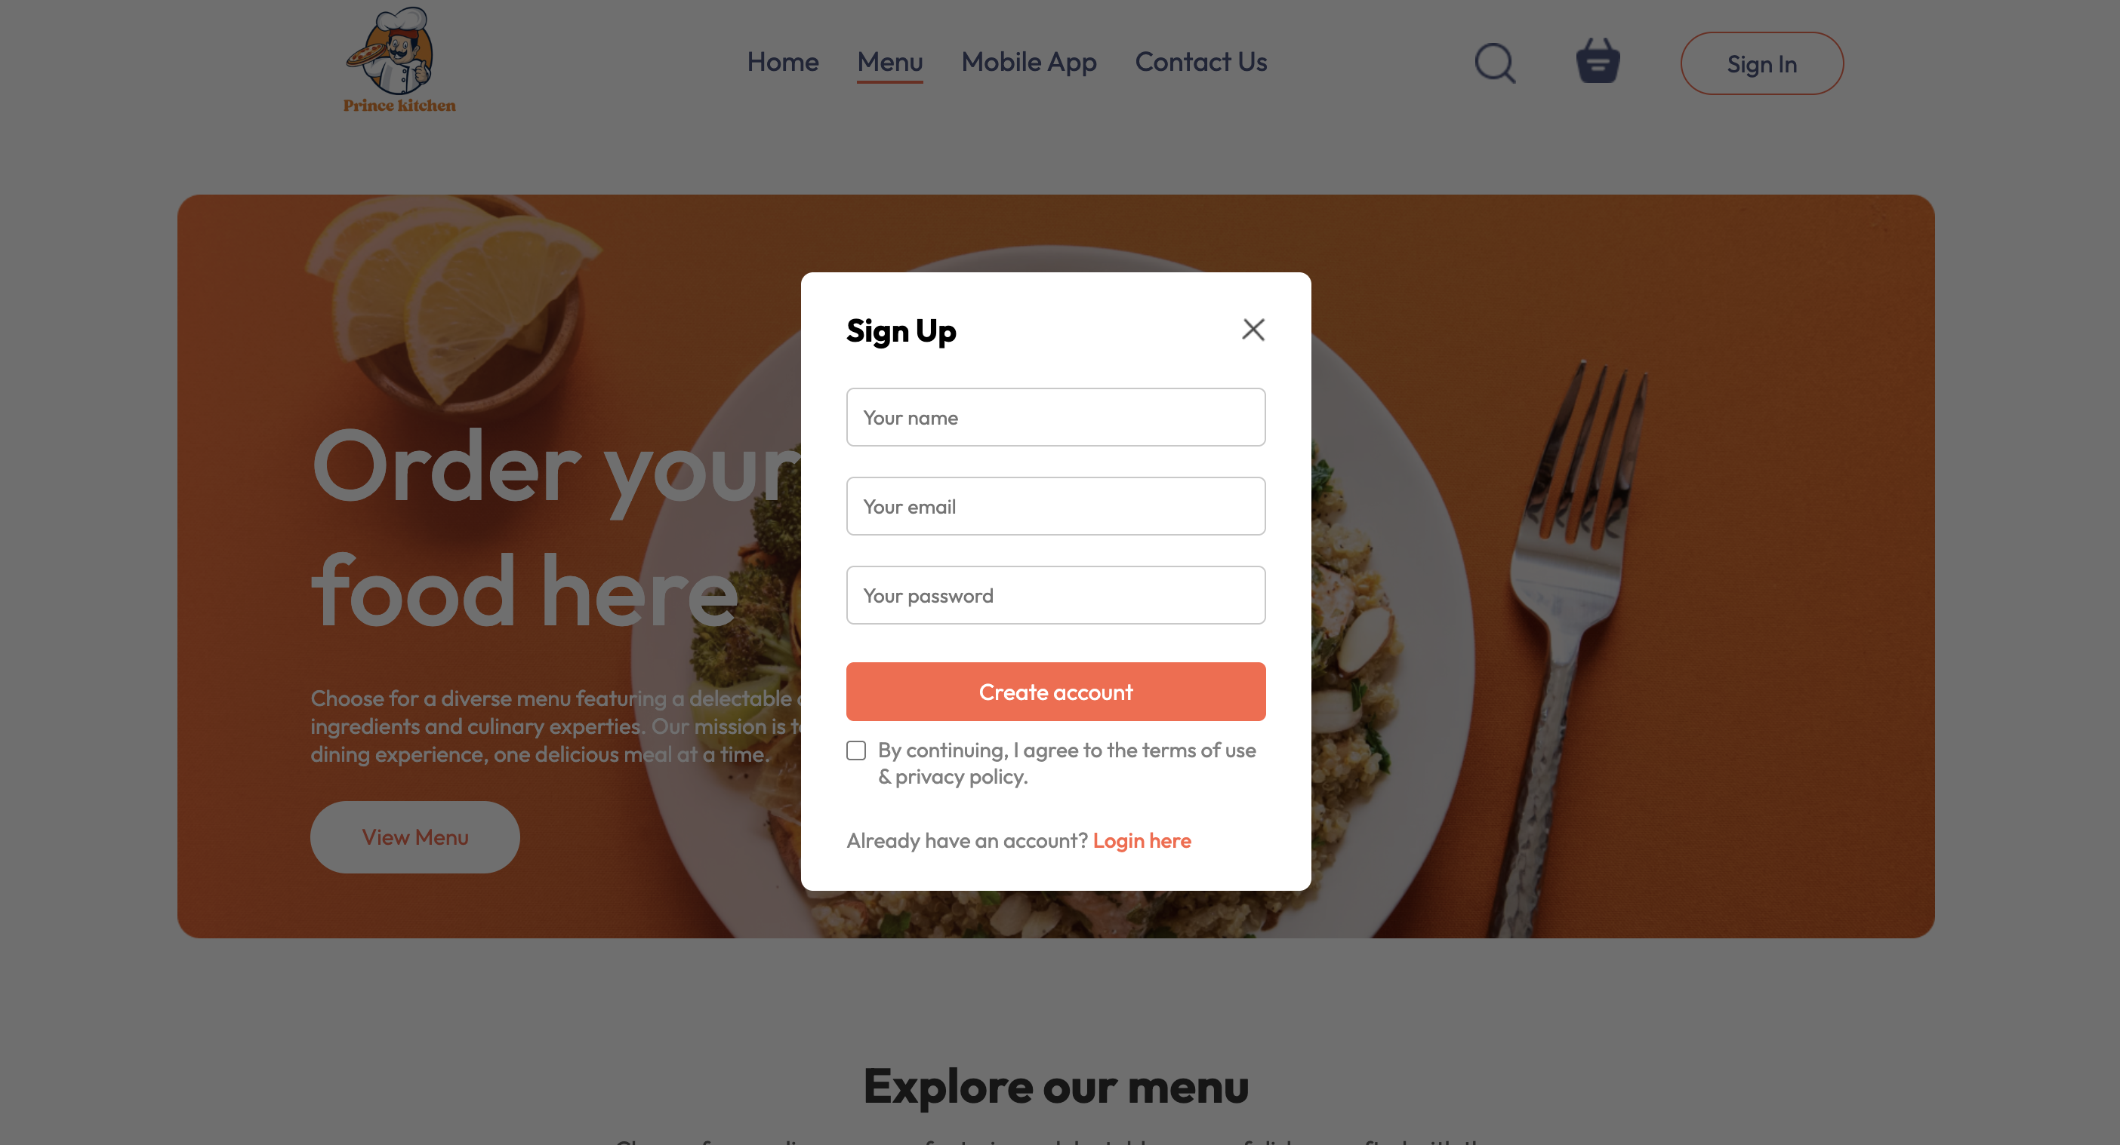
Effortless Onboarding: User Registration
Our streamlined registration process ensures new users can quickly create an account and begin their food delivery journey. Designed for simplicity and security, this screen captures essential user information while providing a clear path to accessing the app's full features.
Quick Setup: Users can register with just a few key details, minimizing friction and speeding up access to services.
Secure Credentials: The platform prioritizes user security with robust password protocols and optional integration with existing social accounts for convenience.
Personalized Experience: Information gathered during signup enables a tailored user experience, including personalized restaurant recommendations and efficient order management.

Slide 9
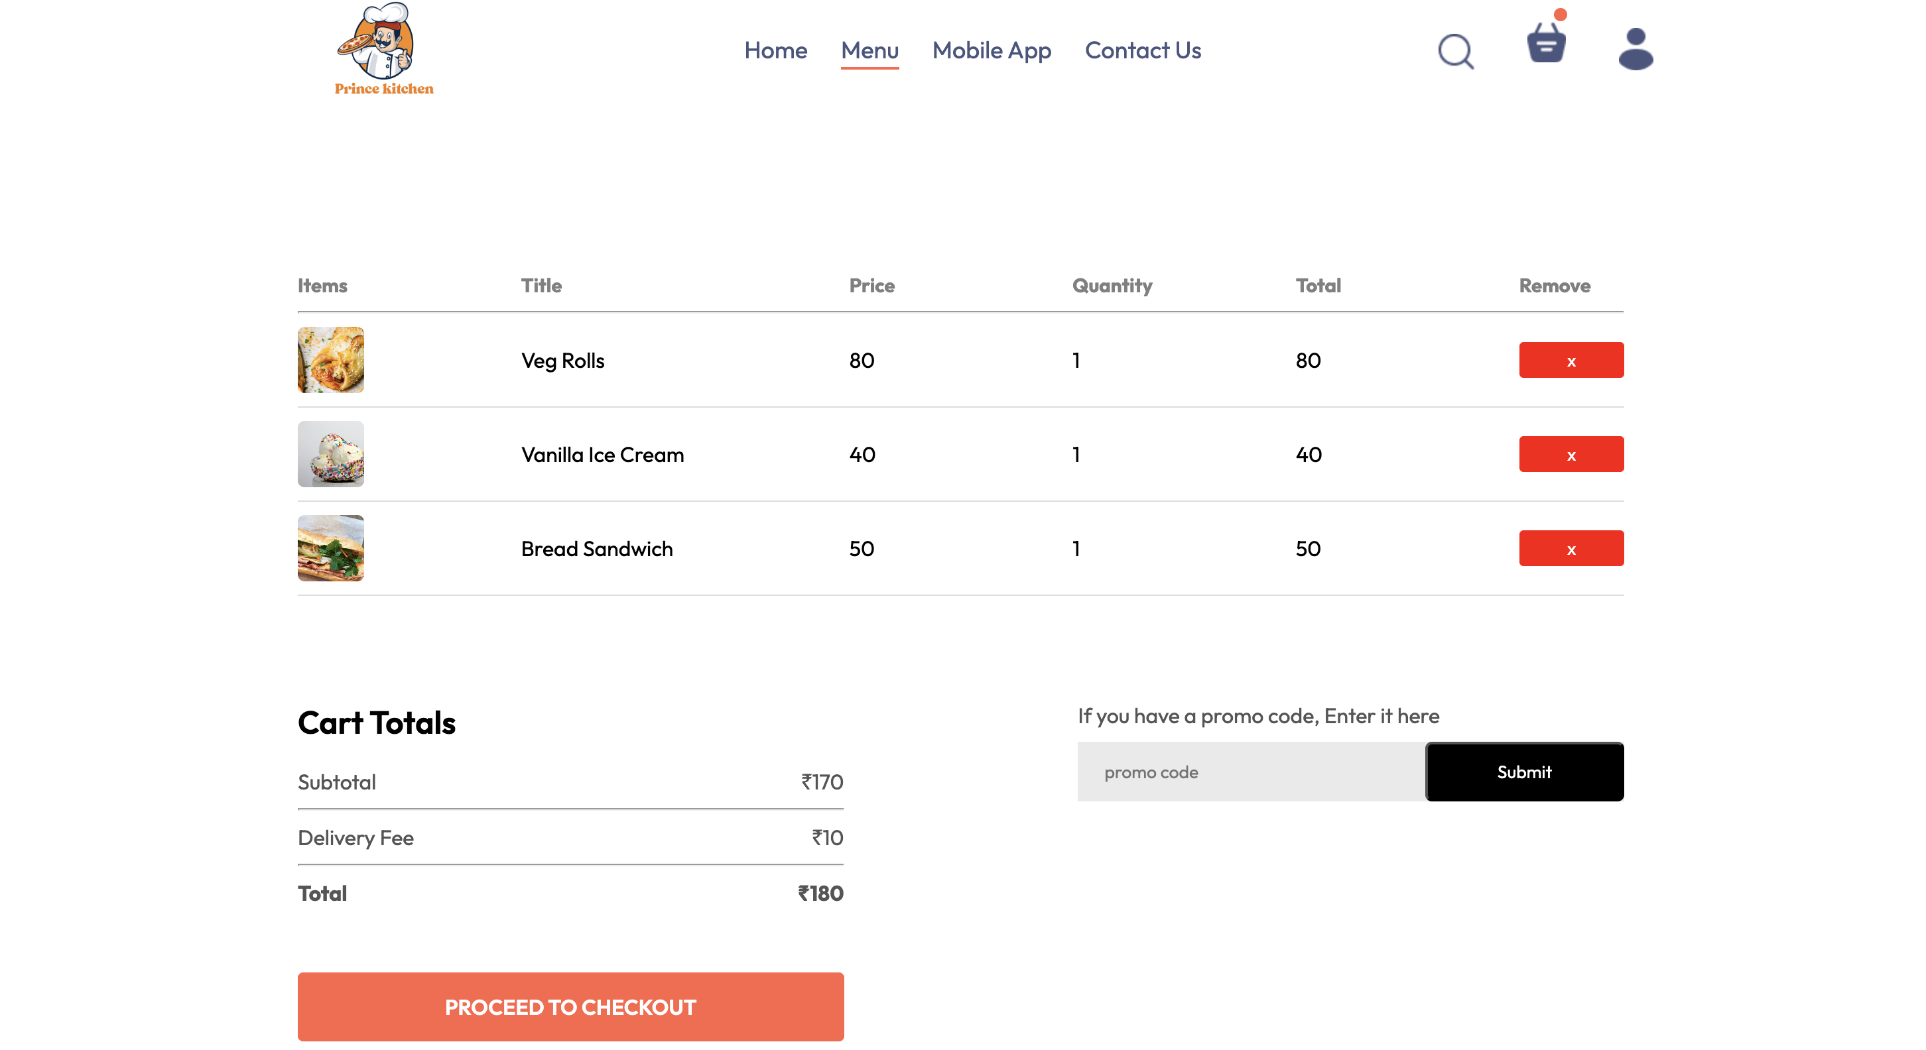
Shopping Cart: Effortless Order Management
The Shopping Cart screen provides users with a comprehensive overview and full control over their selected items before proceeding to checkout. It's designed for clarity and ease of modification, ensuring a transparent ordering experience.
Order Review: Users can easily view all selected food items, their quantities, and individual pricing.
Transparent Cost Breakdown: A clear display of the subtotal, applicable delivery fees, taxes, and the final total amount due ensures full financial transparency.
Dynamic Order Modification: Intuitive controls allow users to adjust item quantities, add special instructions, or remove items from their cart.
Seamless Checkout Transition: A prominent "Proceed to Checkout" button guides users efficiently to the next stage of the purchasing process.

Slide 10
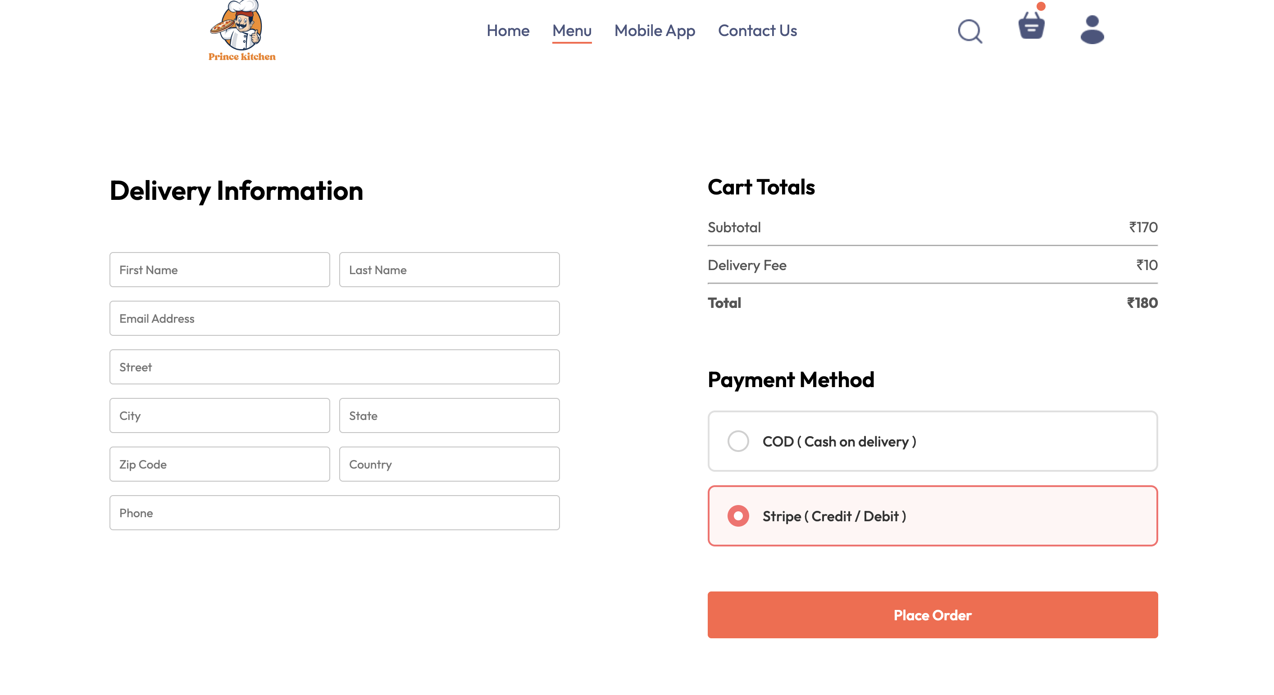
Streamlined Delivery & Payment Options
This card showcases the intuitive and secure checkout process within the application, guiding users through delivery details and flexible payment selections before order finalization.
Delivery Information: Users can easily input and manage their delivery addresses, including options for specific delivery instructions (e.g., "leave at door," "ring doorbell"). The interface prioritizes clarity and efficiency for accurate order delivery.
Flexible Payment Methods: The app supports a variety of payment options to accommodate user preferences. This includes secure credit/debit card processing and integration with popular digital wallets, ensuring a smooth and convenient transaction experience.
Order Summary and Confirmation: Before finalizing the order, users are presented with a clear summary of their selected items, delivery fees, and total cost. This transparency builds trust and allows for a final review.
User Experience Focus: The design emphasizes ease of use, with clear calls to action and minimal steps required to complete an order, reducing friction and improving conversion rates.

Slide 11
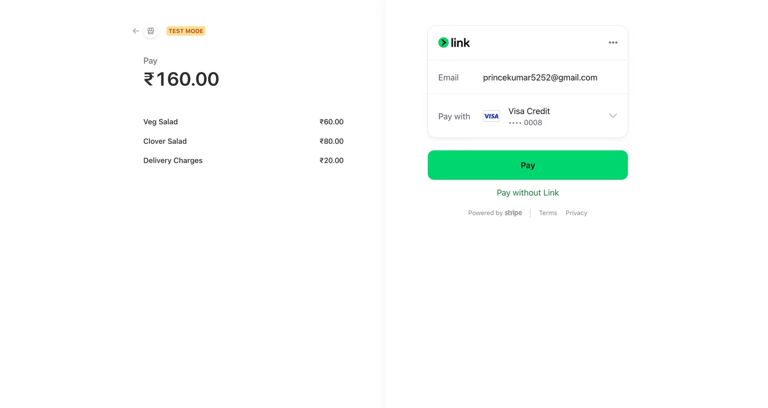
Integrated Payment Solutions: Powered by Stripe
Ensuring a smooth, secure, and efficient transaction process is paramount for any food delivery application. Our platform leverages Stripe, a leading global payment gateway, to provide users with a trusted and convenient checkout experience.
The screenshot above illustrates the seamless integration of Stripe into our payment flow, designed for clarity and ease of use. Key features include:
Robust Security: All transactions are processed through Stripe's PCI-compliant infrastructure, offering industry-leading encryption and fraud detection to protect user financial data.
Diverse Payment Options: Users can easily add and manage various payment methods, including major credit and debit cards, ensuring flexibility and convenience.
Streamlined Checkout: A clean and intuitive interface guides users through the payment process, minimizing friction and enabling quick order finalization.
Saved Payment Details: For returning customers, the option to securely save payment information simplifies future purchases, enhancing the overall user journey.
This integration reflects our commitment to providing a reliable and trustworthy platform, fostering user confidence with every transaction.

Slide 12
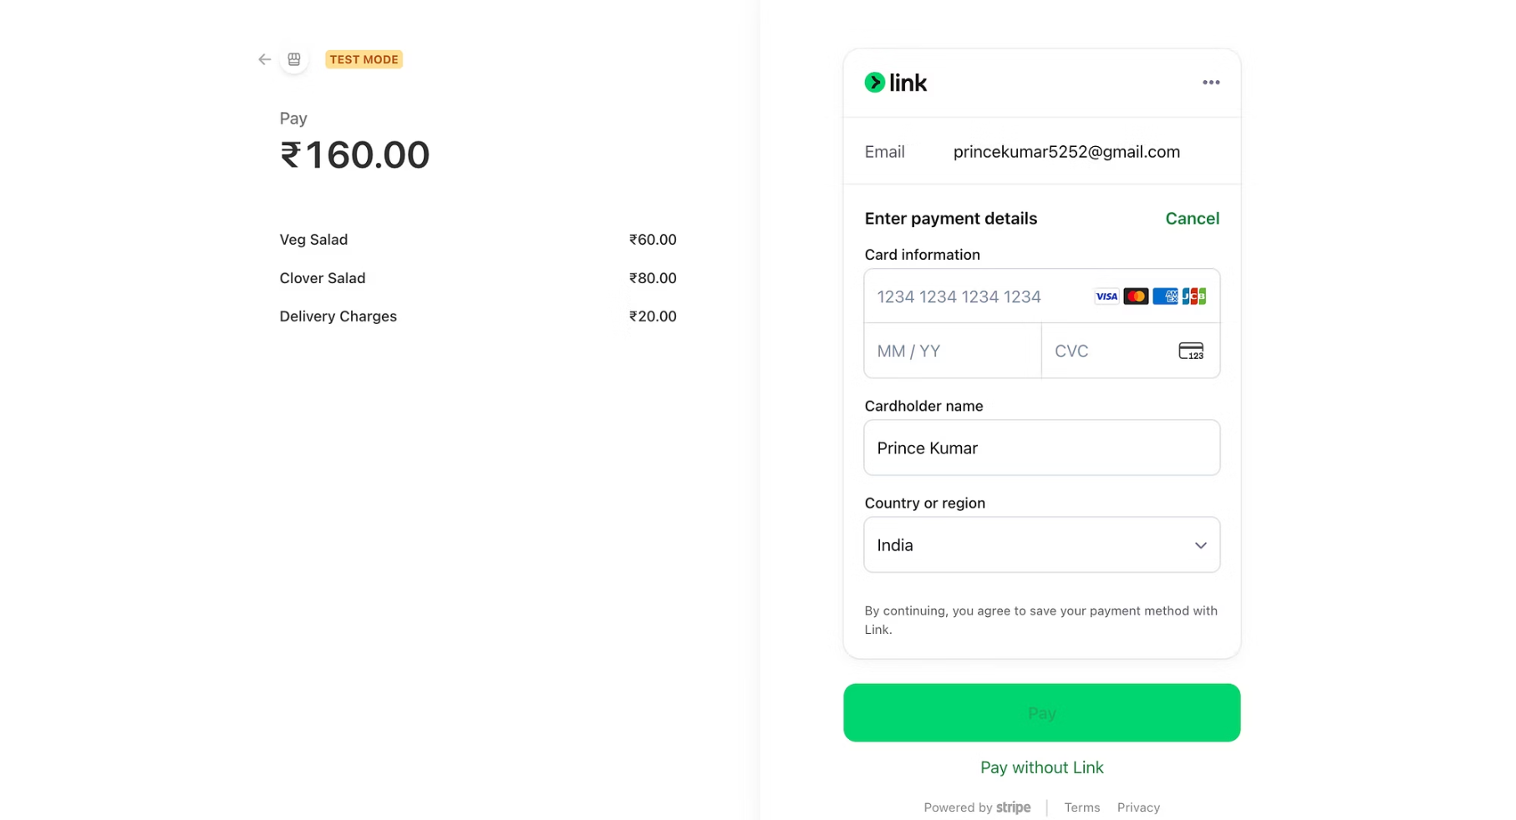
Flexible Payment Methods for a Seamless Checkout Experience
Our food delivery application prioritizes user convenience and security by offering a comprehensive suite of payment options, powered by Stripe's robust integration. This ensures that customers can easily complete their orders using their preferred and trusted payment methods, minimizing friction and enhancing the overall purchasing journey.
Comprehensive Payment Options
Credit and Debit Cards: Support for all major credit and debit cards, allowing users to quickly input and save their card details for future purchases.
Digital Wallets: Seamless integration with popular digital wallets such as Apple Pay and Google Pay, enabling one-tap payments for a faster and more secure checkout.
Secure Processing via Stripe: Leveraging Stripe's industry-leading payment infrastructure ensures all transactions are processed with the highest level of security, encryption, and fraud prevention measures.
User-Friendly Management: Customers can easily add, remove, and select their preferred payment methods directly within the app, providing flexibility and control over their financial transactions.
Benefits for Users and Business
Enhanced User Experience: A wide array of payment choices caters to diverse user preferences, leading to higher satisfaction and repeat business.
Increased Conversion Rates: Reduced payment friction at checkout minimizes cart abandonment and drives more completed orders.
Global Scalability: Stripe's extensive global reach allows for easy expansion into new markets and support for various local payment methods as needed.
Robust Security: Advanced security features protect both user data and business revenue, building trust and confidence in our platform.

Slide 13
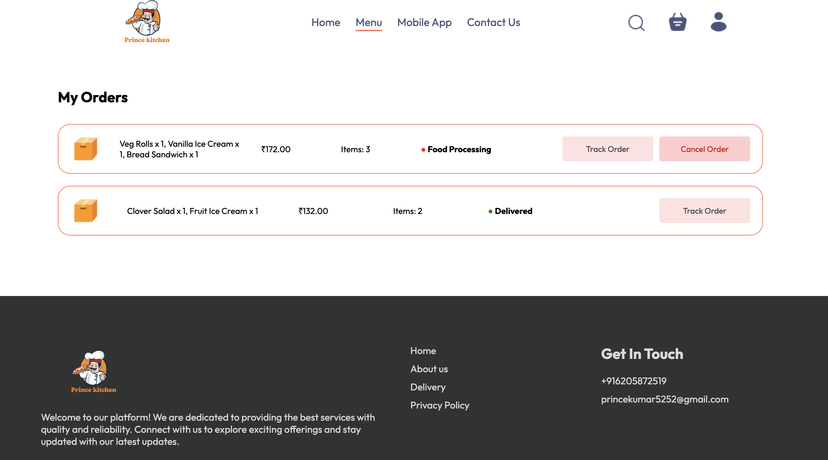
Order Management: Real-time Tracking and Details
The "My Order" screen provides users with comprehensive visibility into their active and past orders, ensuring a seamless and transparent delivery experience. This central hub allows customers to monitor their food delivery from preparation to arrival, fostering trust and convenience.
Key features and functionality displayed:
Current Order Status: Clearly indicates the live progress of an order, such as "Order Confirmed," "Preparing," "Out for Delivery," or "Delivered."
Real-time Tracking: Integrates with a map interface (not fully shown in this screenshot but implied by order flow) to visualize the delivery driver's location and estimated arrival time.
Detailed Order Breakdown: Users can view the complete list of items ordered, including quantities and any special instructions.
Restaurant and Driver Information: Access to details about the restaurant and, once assigned, the delivery driver, including contact options for support.
Order History: A record of previous orders, allowing for quick reordering of favorites and review of past transactions.
Customer Support Access: Direct links to support options for any issues or inquiries regarding an order.

Slide 14
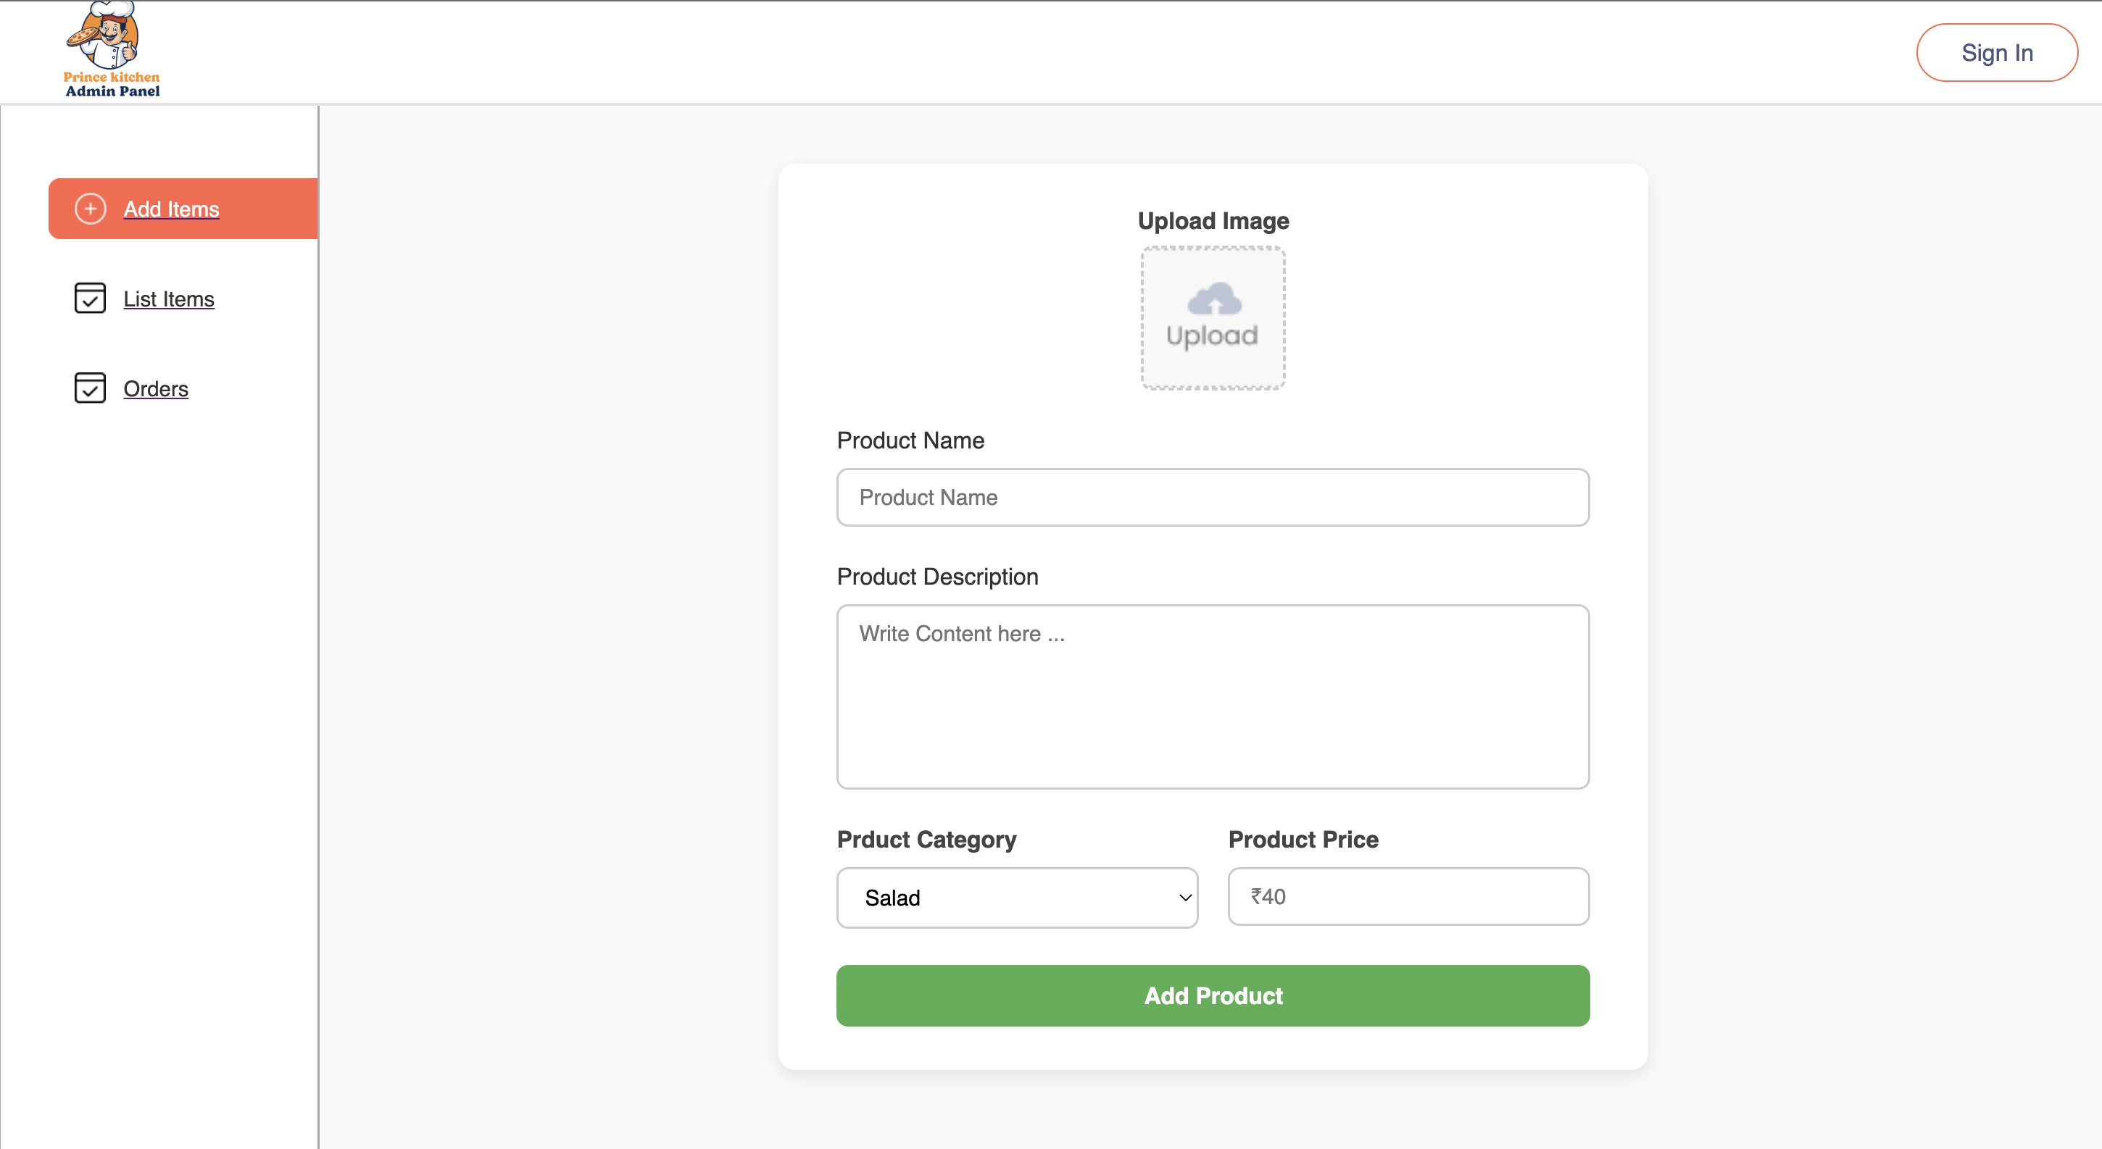
Administrator Dashboard: Efficient Menu Management
This screen provides restaurant administrators with a powerful and intuitive interface to manage their menu offerings. It streamlines the process of adding, editing, and organizing food items, ensuring an up-to-date and appealing menu for customers.
New Item Creation: Clearly labeled fields allow administrators to input essential details such as 'Food Name', 'Description', 'Price', and assign each item to a relevant 'Category'.
Visual Presentation: The integrated image upload feature enables the addition of high-quality photos for each dish, enhancing the visual appeal of the menu and aiding customer selection.
Real-time Updates: Any modifications or additions made within this panel are instantly reflected across the customer-facing application, providing flexibility for daily specials or stock adjustments.

Slide 15
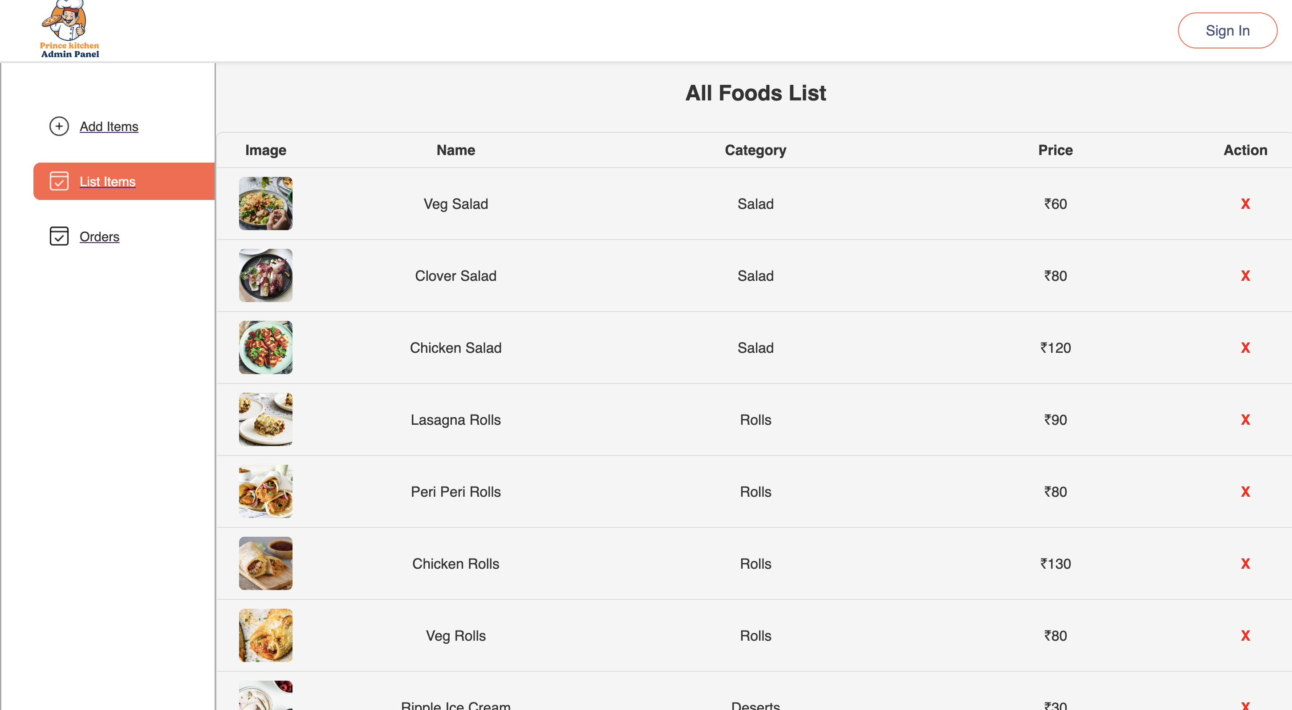
Admin Panel: Menu Management - Food List & Item Creation
This screen provides administrators with a comprehensive overview and control over the restaurant's menu items. It serves as the central hub for managing the food catalog, ensuring accurate and up-to-date offerings for customers.
Food Item Listing: Displays all currently available food items, allowing for quick review and navigation.
Add New Food: A dedicated feature enables administrators to seamlessly add new dishes to the menu, complete with details such as name, description, pricing, and category.
Efficient Management: Facilitates efficient updates, additions, and removals of menu items, which is crucial for dynamic restaurant operations and seasonal menu changes.

Slide 16
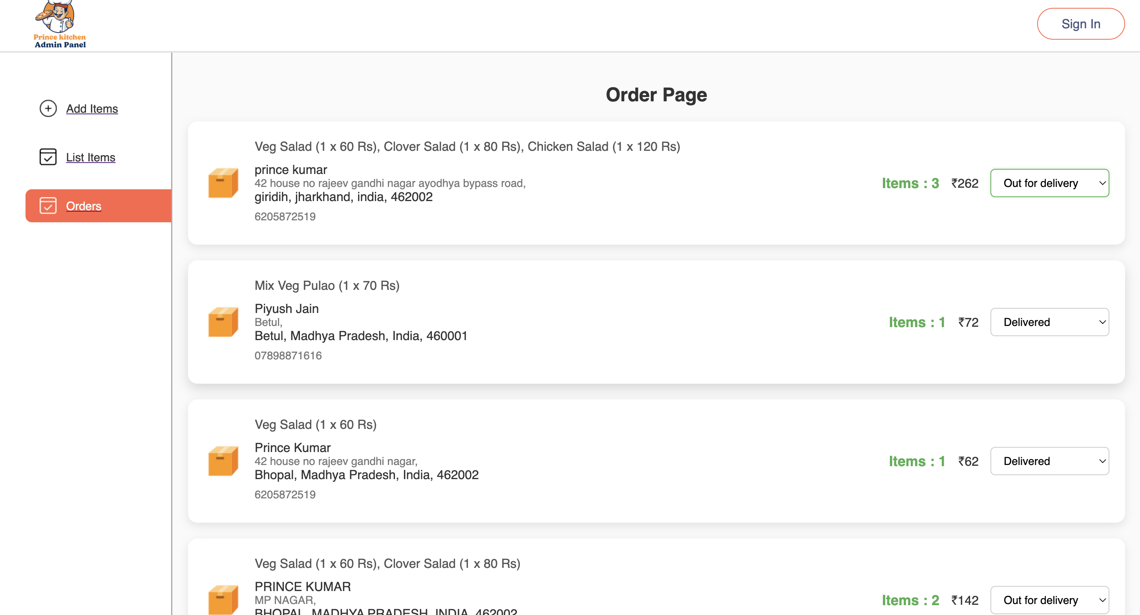
Streamlined Order Management: Real-time Delivery Status for Administrators
This critical administrative interface provides a comprehensive overview of all active and pending food delivery orders, empowering your team to manage operations with precision and efficiency.
Real-time Order Tracking: Administrators can view the current status of every order, from placement to delivery, ensuring full visibility into the delivery process.
Dynamic Status Updates: The platform enables quick and easy updates to order statuses, such as 'Preparing', 'Out for Delivery', and 'Delivered', which are immediately reflected for both the customer and delivery personnel.
Enhanced Operational Control: By providing immediate tools for status changes, the system helps streamline workflows, reduce delays, and improve overall delivery logistics.
Improved Customer Experience: Accurate and timely status updates keep customers informed, building trust and satisfaction with every order.

Slide 17
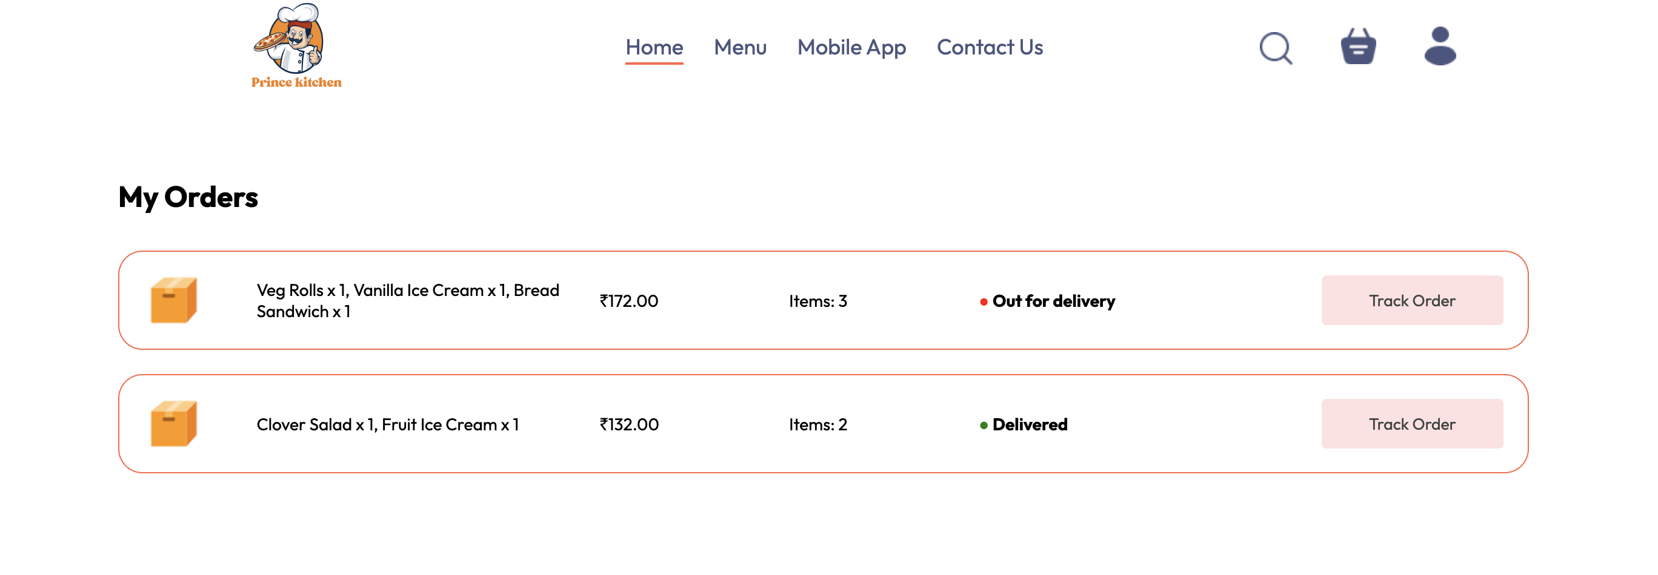
Customer Order Tracking: Real-time Status Updates
This screen provides customers with a transparent and real-time view of their order's progress, reflecting immediate updates made by the administration. It ensures customers are always informed about their delivery status, enhancing trust and satisfaction.
Key Features for the Customer:
Dynamic Status Display: The order status is instantly updated, showing clear labels such as "Preparing," "Out for Delivery," or "Delivered."
Real-time Progress: Customers can track each stage of their order, from preparation to dispatch, providing a seamless and anxiety-free experience.
Enhanced Transparency: By directly linking admin updates to the customer interface, the app fosters greater transparency in the delivery process.
Improved Communication: Reduces the need for customers to contact support for status inquiries, as information is readily available.
This feature is critical for a positive user experience, giving customers peace of mind and demonstrating the efficiency of our delivery system.

Slide 18
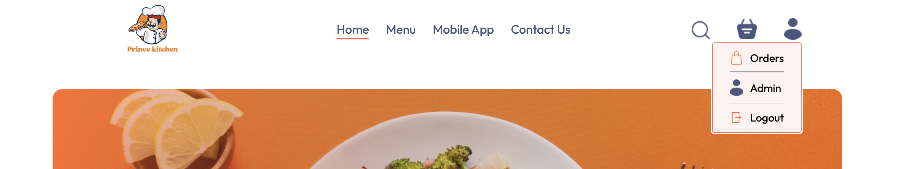
User Profile & Order History
The User Profile screen serves as a central hub for customers to manage their personal information and track their orders within the application. This intuitive interface is designed for ease of access and comprehensive control over the user's account details and delivery history.
Key Features:
Personalized Profile Access: Users can securely view and update their personal details, including name, contact information, and delivery addresses, ensuring their account is always accurate.
Comprehensive Order History: A dedicated section allows users to easily review all past and current orders, providing transparency and a convenient way to reorder favorites or check delivery statuses.
Seamless Order Tracking: From this profile, users can navigate directly to detailed order tracking, offering real-time updates on their food delivery from preparation to arrival.
This screenshot represents a developmental stage, highlighting the user-facing profile features. It's important to note that all administrative functionalities, such as product management and authentication for backend operations, will be robustly separated and managed via distinct, secure admin panels in the final product release.

Slide 19
THANK YOU

